Slide 1
Tools for Team Building & Team Development
EIT Digital Master School @Eötvös Lorand University
Business Development Lab

Slide 2
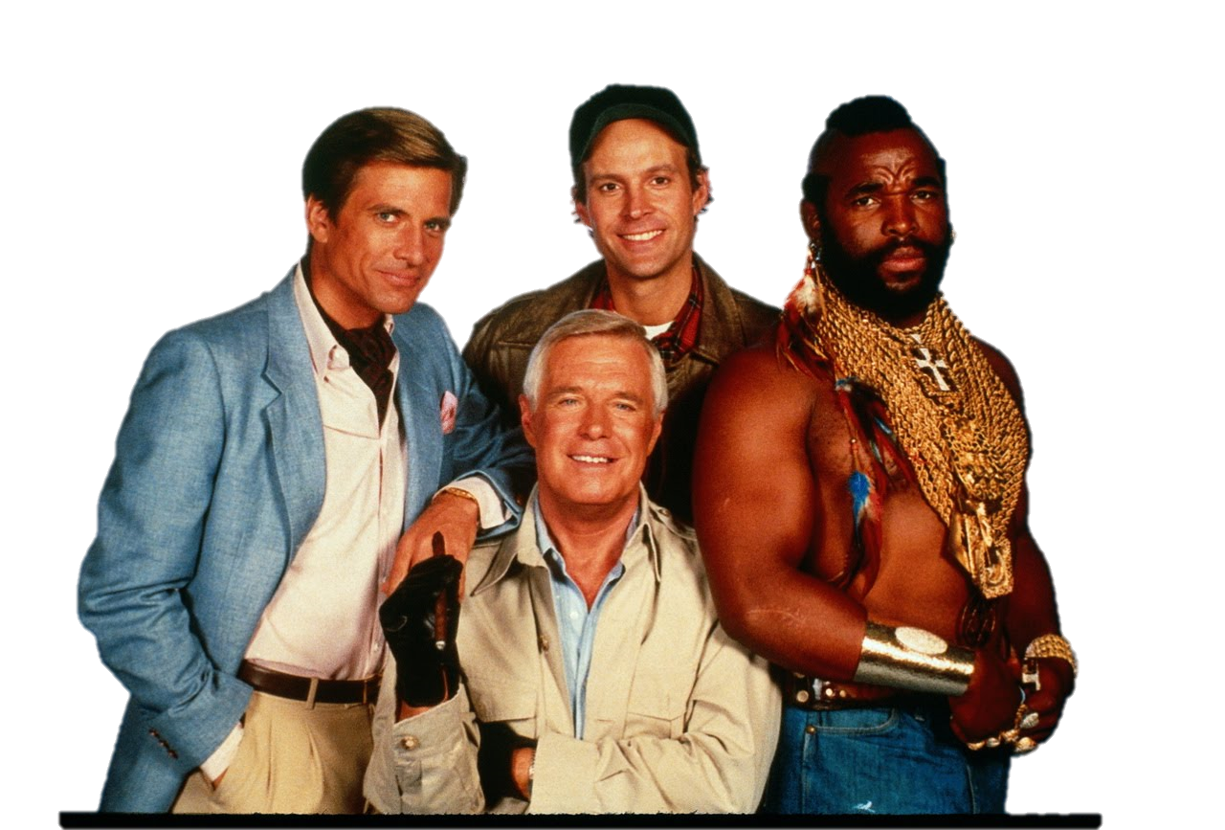

What’s A Team?
(Together Everyone Achieves More)
“A group of people with a full set of complementary skills required to complete a task, job, or project.
It is more than just a collection of people when a strong sense of mutual commitment creates synergy, thus generating performance greater than the sum of the performance of its individual members.”
*http://www.businessdictionary.com/definition/team.html

Slide 3


Team Members
operate with a high degree of interdependence
share authority and responsibility for self-management,
are accountable for the collective performance,
work toward a common goal and shared rewards.
*http://www.businessdictionary.com/definition/team.html

Slide 4
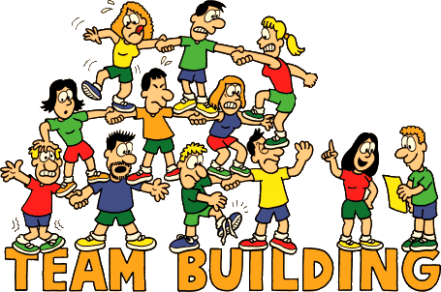
Team Building
“Team building is the process of forming, growing, and improving the knowledge, skills and attitudes of individuals with different needs, backgrounds, and abilities into an integrated, high-performance team.”
*Cleland (1996)

Slide 5

Models of Teamwork Theory
1. Beldin’s team role theory;
2. Abraham Maslow Hierarchy of Needs theory;
3. John Adair Leadership theory;
4. Isabel Briggs-Myers’s MBTI theory;
5. Douglas McGregor X and Y theory;
6. Tajfel, Social Identity theory;
7. Jung’ colour works theory;
8. Tuckman’s theory of group development;
5

Slide 6
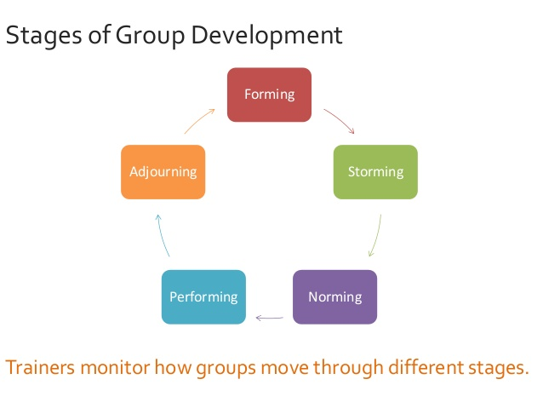
Group Development
Dr. Bruce Tuckman in 1965
A theory of how teams develop from the very start of a project to the end
It describes four main stages, although he added a fifth stage (1975)
6

Slide 7

Objective of Group Development
“Enhancement of the effectiveness of work groups, by improving goal- and role-clarification and interpersonal processes.”
* http://www.businessdictionary.com/definition/team-development.html

Slide 8

Basic Facts about Team Development
As a team develops, relationships between members can stabilize, increasing the ability to perform.
The team development will repeatedly go trough different stages
The amount and the number of times they cycle will vary depending on the team, the environment and the leadership.

Slide 9

Basic Facts about Team Development
Thus the leader has great power in influencing the team development.
Based on what stage the team is in, the leader should change their leadership approach to best meet their needs.

Slide 10
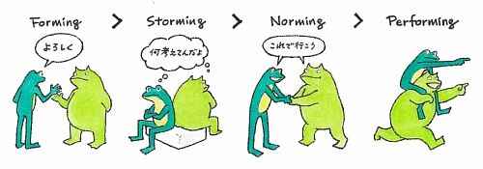
Team development Stages in Brief
Forming:
Team members are getting to know one another, and understanding the team’s purpose and their roles.
There is great uncertainty.
Members begin the process of defining the group’s purpose, structure, and leadership.

Slide 11
Team development Stages in Brief
Storming:
Politeness starts wearing off and dissension occurs
Especially over basic mission and operating procedures.
Intragroup conflict occurs as individuals resist control by the group and disagree over leadership.

Slide 12
Team development Stages in Brief
Norming:
When team members recognize their differences and have dealt with them.
Close relationships develop as the group becomes cohesive and establishes its norms for acceptable behavior.
“How are we going to accomplish our work?”

Slide 13
Team development Stages in Brief
Performing:
This is the final stage of team development.
A fully functional group structure allows the group to focus on performing the task at hand
as an highly effective, problem-solving unit.

Slide 14
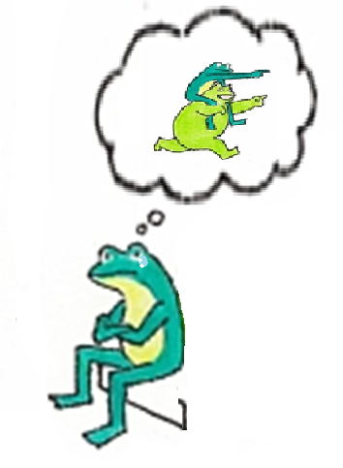
Team development Stages in Brief
Adjourning:
As a project comes to an end or a team member leaves.
This is not a developmental stage but one of closure characterized by concern with wrapping up activities rather than performance.
This is an exciting time but a sad one as well. There is a sense of fulfillment together with loss of team unity.

Slide 15
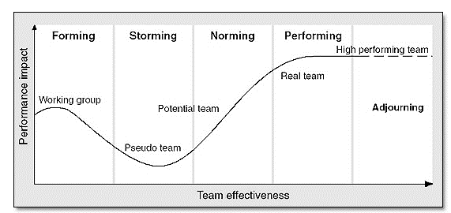
Basic Facts about Team Development
It takes time to reach the “performing” stage; It’s normal for teams to go through ups and downs particularly in the early period(“storming”)
*https://mercureaace2013.files.wordpress.com/2013/01/groupstages.png

Slide 16
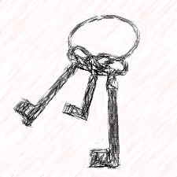
KEYS
Keys to Enhance Your Supervisory Success by University of California, Berkeley
Table referring to team development stages and leadership objectives
Multiple exercises and tools proposed according to the stage
Useful external references to delve into
Find it @ http://hr.berkeley.edu/sites/default/files/keys-teambuildingtoolkit.pdf

Slide 17
How to approach any TD Activity
Step 1. Before: Select an activity that's good for your team (Start with a clear objective in mind)
Step 2. Before: Prepare for your team-building activity (Read, Obtain materials, Anticipate problems)
Step 3. During: Explain the activity to the team (and why you are doing it.)
Step 4. During: Check for understanding before beginning
*KEYS - Keys to Enhance Your Supervisory Success pg 12-13

Slide 18
How to approach any TD Activity
Step 5. During: Run the activity (Don't stop the activity unless it really runs amuck.)
Step 6. During: Debrief the activity (Watch for indications of agreement with what is being said by others.)
Step 7. After: Reinforce the learning back on the job (Refer to the activity and the lessons learned often)
*KEYS - Keys to Enhance Your Supervisory Success pg 12-13

Slide 19
Forming Stage
Focus: Orientation
Team Behavior: Dependence on leader
Leader Role: Direct
Leader Activities:
• Outline objectives, roles, working procedures
• Communicate expectations
• Establish ground rules
• Learn about your team members
• Provide opportunities for team to get acquainted
Suggested Team Exercises and Tools:
• Exercise – Shared Values, pgs. 23-24
• Exercise – Developing a Mission, pgs. 27-28
• Exercise – Sweet Stories, pgs. 44-45
• Tool – Setting Team Ground Rules, pgs. 29-30
• Tool – Project Charter Instructions & Template, pgs. 31-38
*http://hr.berkeley.edu/sites/default/files/keys-teambuildingtoolkit.pdf

Slide 20
Storming Stage
Focus: Clarification
Team Behavior: Conflict
Leader Role: Coach and Mediate
Leader Activities:
• Encourage direct and frequent communication
• Establish communication guidelines
• Appreciate differences
• Surface, mediate, and resolve conflict
• Reassure team this behavior is normal
Suggested Team Exercises and Tools:
• Exercise – Staff Meeting Check-ins, pgs. 14-15
• Exercise – That Guy & This Guy, pgs. 51-54
• Exercise – Blame Game, pgs. 55-56
• Tool – Leader Actions for Dysfunctional Team Member Behaviors, pgs. 46-49
*http://hr.berkeley.edu/sites/default/files/keys-teambuildingtoolkit.pdf )

Slide 21
Norming Stage
Focus: Communication
Team Behavior: Cooperation
Leader Role: Facilitate
Leader Activities:
• Support members in their emerging roles
• Enable effective communication and flow of data
• Focus on listening and summarizing agreements
• Provide positive and constructive feedback
• Reinforce collaborative work relationships
• Arrange a team-building event
Suggested Team Exercises and Tools:
• Exercise – Meeting Opener – Pack Up Your Troubles, pg. 16
• Exercise – Toss Me Some Feedback, pgs. 64-65
• Tool – Ways to Engage Participants in Creative Thinking & Dialogue, pgs. 59-61
*http://hr.berkeley.edu/sites/default/files/keys-teambuildingtoolkit.pdf )

Slide 22
Performing Stage
Focus: Productivity
Team Behavior: Interdependence
Leader Role: Delegate
Leader Activities:
• Allow a high level of autonomy
• Turn over day-to-day responsibility
• Acknowledge successes and contributions
• Encourage professional development to enhance skills and motivate the team
Suggested Exercises and Tools:
• Exercise – Turning Pressure into Performance, pg. 73
• Exercise – Kudos, pg. 76
• Tool – Six Thinking Hats®, pgs. 68-69
• Tool – RAPID® Tool, pg. 70
*http://hr.berkeley.edu/sites/default/files/keys-teambuildingtoolkit.pdf )

Slide 23
Adjourning Stage
Focus: Closure
Team Behavior: Loss or disengagement
Leader Role: Support
Leader Activities:
• Evaluate and review results
• Acknowledge and celebrate achievements
• Bring closure to the project/team
Suggested Team Exercises and Tools:
• Exercise – Project Lessons Learned Session and Template, pgs. 78-80
• Exercise – Gift to the Team, pg. 82
• Tool – Recognition Celebrations, pg. 77
*http://hr.berkeley.edu/sites/default/files/keys-teambuildingtoolkit.pdf )

Slide 24
Let’s TEAM-UP!

Slide 25
Thank you!
Brought to you by EIT Digital Master School @Eötvös Lorand University
Find me at: anna.reale@inf.elte.hu

